Slide 1
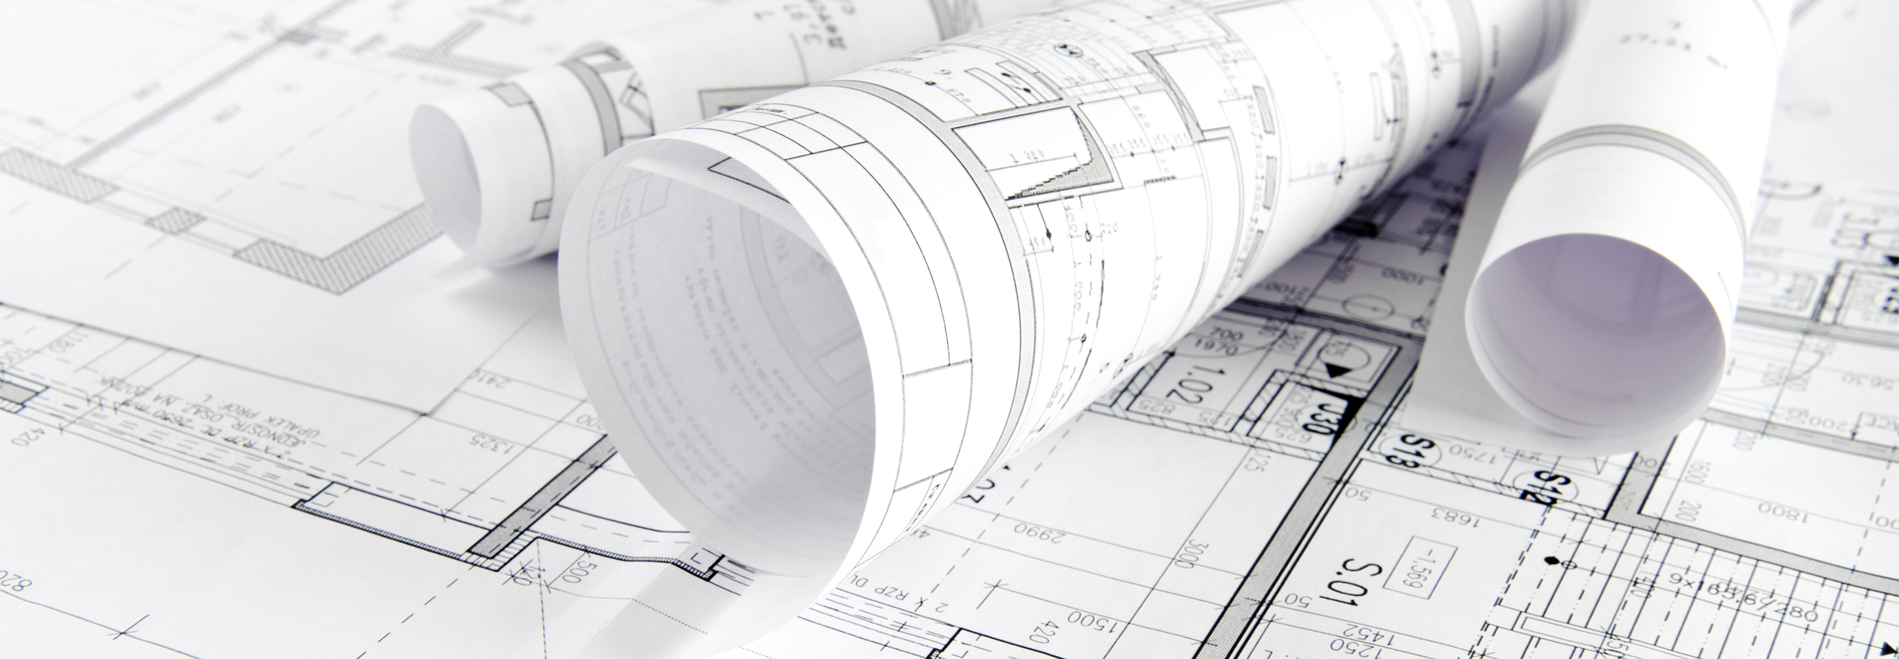
A Year in Review: 2024 Planning Division
Board of Supervisors
January 7, 2025

Slide 2
Staffing
Planning Director
Planning
Code Enforcement
Senior Planner
Associate Planner
Senior Planner
Code Enforcement Officer
Code Enforcement Officer
Code Enforcement Officer
Planning Commission Secretary
Planning Permit Technician
Analyst
Code Enforcement Supervisor

Slide 3
Planning Division Duties
Current Planning
Boundary Line Adjustments (Lot Line Adjustments and Parcel Mergers)
Business License Sign-Off
California Environmental Quality Act (CEQA) Review
Building Permit Sign-Off
Home Occupations
Property Inquiries
Reclamation Plans
Road Name Changes
Tentative Parcel Maps
Tentative Subdivision Maps
Use Permits
Variances
Williamson Act
Zone Changes
Long Range Planning
Update of Planning Documents
Update of General Plan
Zone Code Updates
Development of Policies and Programs
Signs
Certificates of Compliance
Special Projects
General Plan Amendments

Slide 4
Planning Division 2024 Applications
89 Applications Total

Slide 5
2024 Code Enforcement Cases
2024 Total Civil Penalties received (as of December 3, 2024): $441,479

Slide 6
2024 Planning Projects
Vacation Rental Ordinance update
2050 General Plan update (est. completion date 2026)
2023-2031 Housing Element
JH Ranch Planned Development

Slide 7
Williamson Act
545 Total Contracts within the County
70 are Multi-Owner Contracts
A total of 414,961 Acres under Contract
13 Contract Amendments: $15,275 fees
19 Processed and Approved
2On Hold with Issues (Need BLAs)
2 Still in Process
8,853.77 Acres were Issued a Notice of Non-Renewal
230.8 Acres were Added to Existing Contracts

Slide 8
Surface and Mining Reclamation Act (SMARA) Mining Program
25 Mine Sites
1 Is Abandoned and Requires County Closure
2 In Process of Reclamation (By Operator)
3 New Sites in Process
3 Proposed Amendments/Expansions in Process
Annual Fees Billed: $35,000

Slide 9
2025 Outlook: Planning Priorities
JH Ranch Planned Development Amendment
General Plan 2050 Update
Staff Training and AICP Certification
Update Required Ordinances for Housing Element Implementation

